Slide 1

Lecture 0 INT108:: PYTHON PROGRAMMING

Slide 2
Course Overview
Course Code: INT108
Course Title: PYTHON PROGRAMMING
L T P :
Credit: 4
3 | 0 | 2

Slide 3
Program Outcomes (PO)
Outcome | Heading | Description
PO1 | Engineering knowledge | Apply the knowledge of mathematics, science, engineering fundamentals, and an engineering specialization to the solution of complex engineering problems.
PO2 | Problem analysis | Identify, formulate, review research literature, and analyze complex engineering problems reaching substantiated conclusions using first principles of mathematics, natural sciences, and engineering sciences.
PO3 | Design/development of solutions | Design solutions for complex engineering problems and design system components or processes that meet the specified needs with appropriate consideration for the public health and safety, and the cultural, societal, and environmental considerations.
PO4 | Conduct investigations of complex problems | Use research-based knowledge and research methods including design of experiments, analysis and interpretation of data, and synthesis of the information to provide valid conclusions.
PO5 | Modern tool usage | Create, select, and apply appropriate techniques, resources, and modern engineering and IT tools including prediction and modeling to complex engineering activities with an understanding of the limitations
PO6 | The engineer and society | Apply reasoning informed by the contextual knowledge to assess societal, health, safety, legal and cultural issues and the consequent responsibilities relevant to the professional engineering practice.
PO7 | Environment and sustainability | Understand the impact of the professional engineering solutions in societal and environmental contexts, and demonstrate the knowledge of, and need for sustainable development.
PO8 | Ethics | Apply ethical principles and commit to professional ethics and responsibilities and norms of the engineering practice.
PO9 | Individual and team work | Function effectively as an individual, and as a member or leader in diverse teams, and in multidisciplinary settings.
PO10 | Communication | Communicate effectively on complex engineering activities with the engineering community and with society at large, such as, being able to comprehend and write effective reports and design documentation, make effective presentations, and give and receive clear instructions.
PO11 | Project management and finance | Demonstrate knowledge and understanding of the engineering, management principles and apply the same to one’s own work, as a member or a leader in a team, manage projects efficiently in respective disciplines and multidisciplinary environments after consideration of economic and financial factors.
PO12 | Life-long learning | Recognize the need for, and have the preparation and ability to engage in independent and life-long learning in the broadest context of technological change.

Slide 4
Program Specific Outcomes (PSO)
Apply acquired skills in software engineering, networking, security, databases, intelligent systems, cloud computing and operating systems to adapt and deploy innovative software solutions for diverse applications.
Apply diverse IT skills to design, develop, and evaluate innovative solutions for business environments, considering risks, and utilizing interdisciplinary knowledge for efficient real-time projects benefiting society.

Slide 5
Course Outcomes
CO1 :: Describe the installation of python environment and basics of Python language
CO2 :: Apply the conditional and iterative statements for evaluating the appropriate alternates
CO3 :: Explore functions, including recursion, with parameters and arguments in Python.
CO4 :: Construct the core data structures like lists, dictionaries, tuples and sets in Python to store, process and sort the data.
CO5 :: Apply the concepts of Object-oriented programming as used in Python using encapsulation, polymorphism, and inheritance.
CO6 :: Examine file handling operations and effectively apply regular expressions for pattern matching.

Slide 6
Course Outcomes | PO1 | PO2 | PO3 | PO4 | PO5 | PO6 | PO7 | PO8 | PO9 | P10 | P11 | P12 | PSO1 | PSO2
CO1: Describe the installation of python environment and basics of Python language |  |  | 3 |  | 3 |  |  |  |  |  |  | 2 |  | 3
CO2: apply the conditional and iterative statements for evaluating the appropriate alternates |  |  | 3 |  | 3 |  |  |  |  |  |  | 2 |  | 3
CO3: Explore functions, including recursion, with parameters and arguments in Python. |  |  | 3 |  | 3 |  |  |  |  |  |  | 2 |  | 3
CO4 :: construct the core data structures like lists, dictionaries, tuples and sets in Python to store, process and sort the data |  |  | 3 |  | 3 |  |  |  |  |  |  | 2 |  | 3
CO5 :: apply the concepts of Object-oriented programming as used in Python using encapsulation, polymorphism, and inheritance |  |  | 3 |  | 3 |  |  |  |  |  |  | 2 |  | 3
CO6: Examine file handling operations and effectively apply regular expressions for pattern matching |  |  | 3 |  | 3 |  |  |  |  |  |  | 2 |  | 3

Slide 7

Why languages?

Slide 8
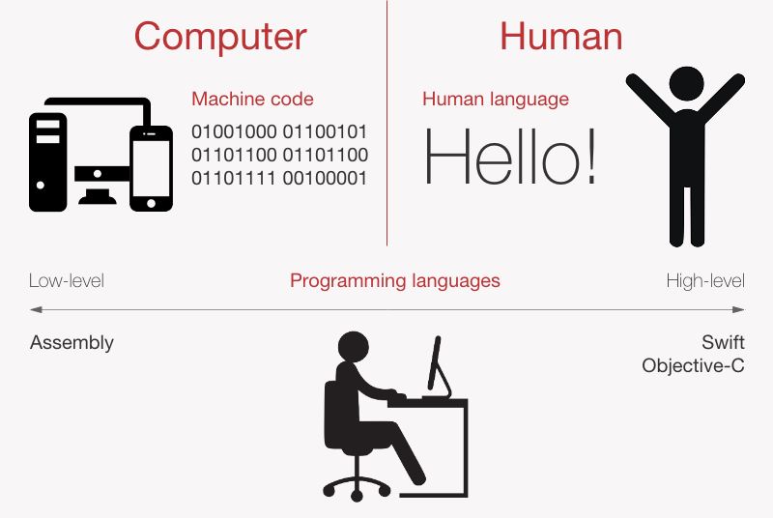
Computer Language vs. Human Language

Slide 9
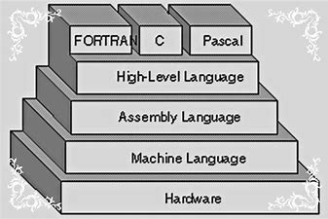
Different Computer Languages

Slide 10
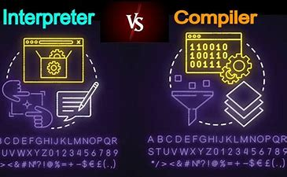
Compiler vs. Interpreter

Slide 11

Make language your Friend

Slide 12
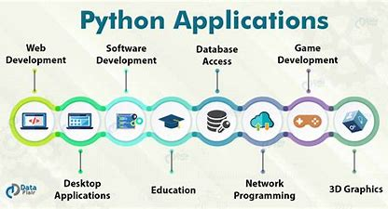

Slide 13
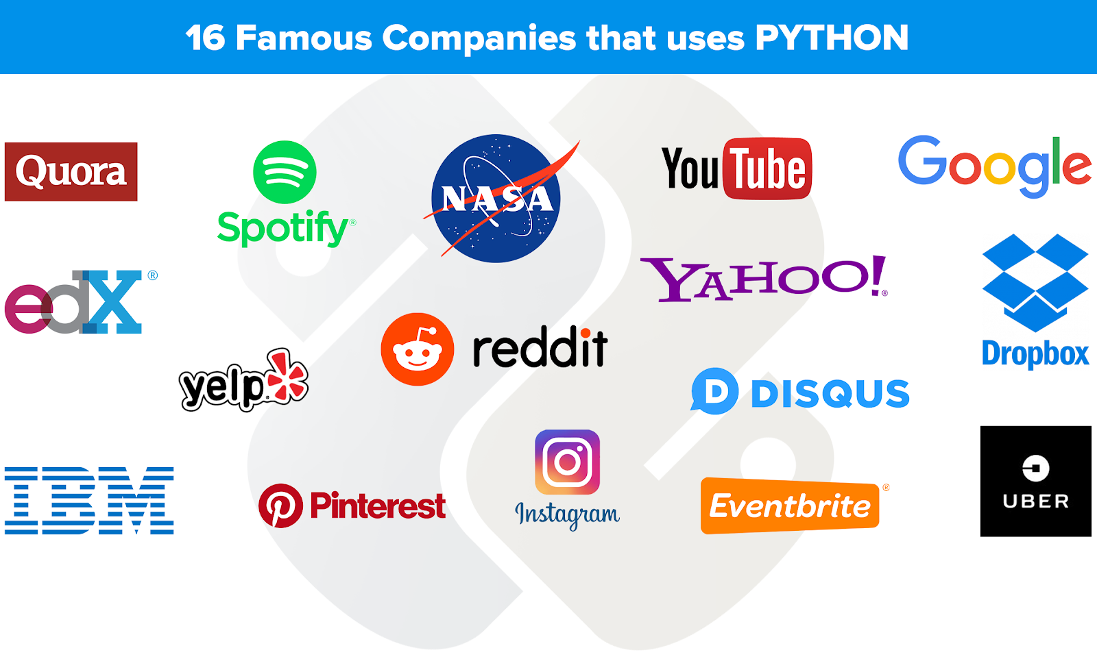

Slide 14

Overview of Unit 1

Slide 15
Unit 1
Setting up your Programming Environment : Python versions, Python on windows, running a ‘Hello World’ program
Variables, Expression and Statements: Naming and using variables, Avoiding Name Error when using variables, Values and types, variables, variables name and keywords, statements, operators and operand, order of operations, operations on string, composition and comments

Slide 16
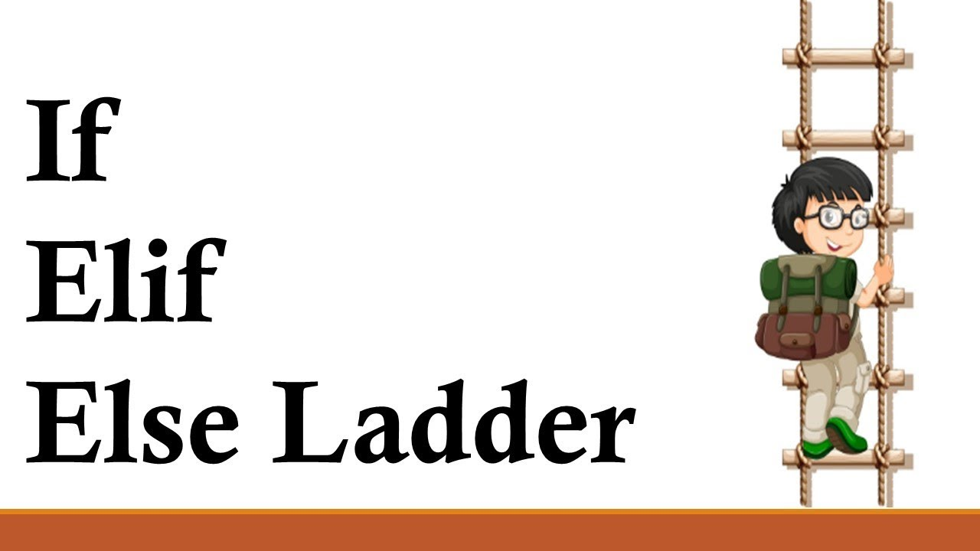
Overview of Unit 2

Slide 17
Unit 2
Conditional statements : modulus operator, Random numbers, Boolean expressions, logic operators, conditional, nested conditionals
Iterative statements : while statements, for loop statement, Nested for, Nested while, Random numbers in loops, encapsulation and generalization

Slide 18
Unit 3
Functions and recursion : function calls, type conversion and coercion, math functions, adding new function, parameters and argument, recursion and its use

Slide 19
Unit 4
String : string a compound data type, length, string traversal, string slices, comparison, find function, looping and counting
Lists : list values, length, membership, operations, slices, deletion, accessing elements, list and for loops, list parameters and nested list.
Tuples and Dictionaries : mutability and tuples, tuple assignment, tuple as return values, dictionaries operations and methods, sparse matrices, aliasing and coping

Slide 20
Unit 5
Classes and objects : Creating classes, creating instance objects, accessing attributes
Object oriented programming terminology : Class Inheritance, Overriding Methods, Data Hiding, Function Overloading

Slide 21
Unit 6
Files and Exceptions : text files, writing variables, Reading from a file, writing to a file, directories, pickling, handling the zero Division error exception, using try-except blocks, The else block, Handling the File Not found error exception
Regular Expressions : Concept of regular expression, various types of regular expressions, using match function, Web Scraping by using Regular Expressions

Slide 22
CA and ETP
CA
Programming Practice(Mandatory) 40 marks
Best 2 out of 3 Test Code -Based each of 30 marks
ETP
2 Coding Problems(70 marks) + viva(30 marks )

Slide 23
Marks Breakup
Marks Breakup:
Note :
20 Marks for programming practice, 15 marks for test code based.
Activity | Marks
Attendance | 5
Continuous Assessment (CA)* | 50(20+15+15)
End-Term Practical (ETP) | 45

Slide 24
Important information
Programming practice(Python Programming course) Student will complete it unit wise on CodeTantra platform.
All code based test will be conducted on CodeTantra platform.
ETP will be conducted on CodeTantra platform.

Slide 25
Programming practice
Each student must solve a mandatory set of 100 static problems(50 MCQ +50 Coding problems) during the class.
For each unit (6 units in total), students must solve 40 randomized problems in form of test totaling 240 problems across all units. These problems are weighted which will be considered during final calculation.

Slide 26
Mandatory condition
To qualify for programming practice marks, students must solve at least 50% of the programming questions and 50% of the MCQ questions.
Each Code based test will contain 10 MCQ questions each of 1 marks and 2 coding questions each of 10 marks.
Duration for code based test will be 1 hour.

Slide 27
Calculation of Final Programming Practice Marks (Out of 40):
Eligibility Calculation:
Determine the percentage of problems solved out of the total required (example: 192 out of 240 problems solved equals 80%).
Calculate the eligible marks based on this percentage from a maximum of 40 marks.
Proctored Coding Contests (CAs) Calculation:
Calculate the percentage of marks scored in the proctored Coding Contests (example:48 out of 60 marks equals 80%).
Final Marks Calculation:
Multiply the eligible marks by the percentage scored in the CAs.
Round up the final marks to the nearest whole number.

Slide 28
Example
If a student solves 192 out of 240 questions : Percentage of questions solved: 192/240×100=80%
Eligible marks: 80%×40=32 marks
If the student scores 24 out of 30 in2 best CAs:
Percentage of marks scored in CAs: 48/60×100=80%
Final Programming Practice Marks:80%×32=25.6
Rounded up to 26 marks out of 40 for Programming Practice

Slide 29
Questions Solved (out of 240) | Percentage Solved | Eligible Marks (Out of 40) | CA Score (Out of 60) | Percentage in CA | Final Marks Calculation | Final Marks (Out of 40)
192 | 80% | 32 | 48 | 80% | 80% of 32 = 25.6, rounded up | 26
120 | 50% | 20 | 30 | 50% | 50% of 20 = 10, rounded up | 10
96 | 40% | Not eligible | 36 | 60% | Not eligible | 0
144 | 60% | 24 | 42 | 70% | 70% of 24 = 16.8, rounded up | 17
216 | 90% | 36 | 54 | 90% | 90% of 36 = 32.4, rounded up | 33
60 | 25% | Not eligible | 18 | 30% | Not eligible | 0
180 | 75% | 30 | 42 | 70% | 70% of 30 = 21, rounded up | 21

Slide 30
Star Course
Hands-on Practice: A good course which include interactive coding exercises to help you apply what you've learned.
This course is a short bite-sized courses that help students develop foundational-level knowledge and skills in Python language. Although the course is packed with high quality content that helps students further with their learning and earn credits.

Slide 31
Blended learning
Third party platform for assessment CodeTantra

Slide 32
Open Educational Resource
Course Code | Course Title | Unit mapped | Broad topic | OER Type | Title of OER | *%age unit mapped with OER (approx) | Source URL
INT108: Python Programming |  | Unit 1 | Setting up your python environment and variables, expression and statements | Reading material (Text) | Introduction to Python Programming/ | 80 | https://www.w3schools.com/python/python_intro.asp https://www.w3schools.com/python/python_comments.asp https://www.w3schools.com/python/python_variables.asp https://www.w3schools.com/python/python_operators.asp https://www.w3schools.com/python/python_comments.asp
 |  | Unit 2 | Conditional and iterative statements | Reading material (Text) | Conditional and iterative statements | 95 | https://www.w3schools.com/python/python_conditions.asp https://www.w3schools.com/python/python_while_loops.asp https://www.w3schools.com/python/python_for_loops.asp

Slide 33
 | Unit 3 | Function and recursion | -Reading Materials *Text | Function and recursion | 80 | https://www.w3schools.com/python/python_functions.asp https://www.w3schools.com/python/python_lambda.asp
 | Unit 4 | String, List, tuple and dictionary | Reading Materials (Pdf) | Different data types and operations | 90 | https://www.w3schools.com/python/python_strings.asp https://www.w3schools.com/python/python_lists.asp https://www.w3schools.com/python/python_tuples.asp https://www.w3schools.com/python/python_dictionaries.asp

Slide 34
 | Unit 5 | Classes and objects, object oriented programming terminology | -Reading Materials *Text | Classes, inheritance, operator overloading, data hiding | 75 | https://www.w3schools.com/python/python_classes.asp https://www.w3schools.com/python/python_inheritance.asp
 | Unit 6 | Files and exceptions, regular expression | -Reading Materials *Text | File and exception handling | 75 | https://www.w3schools.com/python/python_file_handling.asp https://www.w3schools.com/python/python_file_open.asp https://www.w3schools.com/python/python_try_except.asp

Slide 35


Slide 36


